Slide 1
CCDA Data Exchange for Transition of Care
Presented By:
Pooja sree Bolisetty
Sucharitha Dammareddygari
Nikhil Lakkireddypalli
Prudhvi Rajasekhar Sabbavarapu
Niraj

Slide 2
Previous State of Health IT
Patient records: manually maintained and stored in physical files.
Different departments/providers maintained separate records for the same patient.
Sharing data quickly and accurately was difficult.
Billing and insurance claims - collected manually- paper forms, --> delays and errors.

Slide 3
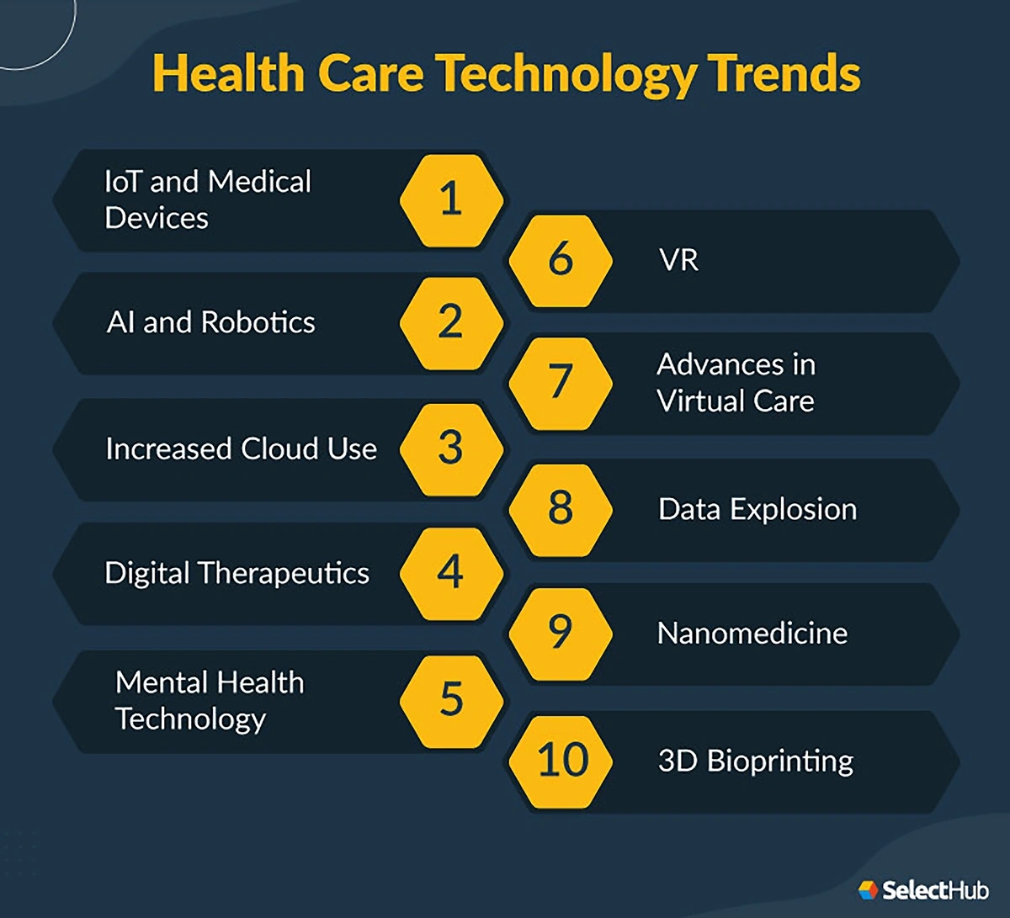
Current State of Health IT
implementation of EHRs and EMRs.
Digital records :a comprehensive view of patient health history.
seamless sharing with
healthcare providers,
laboratories,
pharmacies, and others.

Slide 4
Consolidated Clinical Document Architecture (C-CDA)
HL7 Standard - facilitate the exchange of clinical documents between the healthcare providers.
Improve the quality of care - ensuring information is accurately and securely shared.

Slide 5
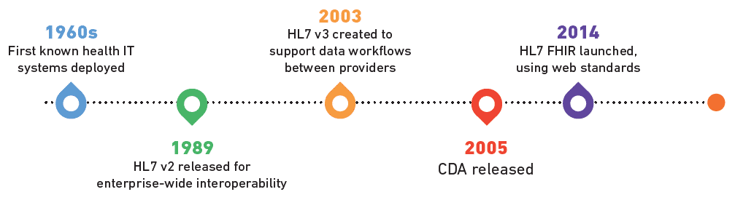

Slide 6
 | HL7 V2 | HL7 V3 | HL7 CDA | HL7 FHIR
General Structure | Message | Structured message | Document | API
Use cases | Medical record exchange | Medical record exchange | Clinical document exchange | Universal health data exchange, including apps, smart devices, and wearables. FHIR enables sharing medical records, individual patient data, provider data, and other data sources as needed.
Platform | EMR, EHR, HIS | EMR, EHR, HIS | EMR, EHR, HIS | EMR, EHR, HIS, mobile apps, and wearables

Slide 7
Stakeholder Insights
we interviewed stakeholders from
MDDHS,
MiHIN,
Blue Cross Blue Shield, and
Network OneD

Slide 8
Limitations of Previous data methods
Disconnected systems hinder seamless workflows.
Manual processes introduce a higher risk of errors and reduce operational efficiency.
Incomplete or missing data necessitates repeated diagnostic tests, impacting care quality.
The process of integrating records is time-consuming, delaying critical decision-making.
Restricted patient access to their health information limits engagement and involvement in care.

Slide 9

Limitations of Previous data methods
Paper-based systems are susceptible to data breaches and potential loss of critical information.
Inconsistent data formats make it hard to compare or combine data.
Paper-based systems and manual work waste money.
Providers spend more time finding information than treating patients.

Slide 10

Goals of CCDA Data Exchange
Smooth and standardized data transfer.
Gathers all necessary patient information in one place.
Reduces errors and saves time with automated processes.
Enables advanced data analysis to optimize care quality and decision-making.
Enhances equitable access to healthcare services.
Drives measurable improvements in patient outcomes.

Slide 11
CCDA Framework
CCDA (Consolidated Clinical Document Architecture)- a standardized format for exchanging clinical information.
Key Elements in CCDA Documents:
Medical history
Allergies
Medications
Lab results
Discharge summaries

Slide 12
CCDA’s Role in Healthcare Data Exchange
Standardization:
Provides a common format for clinical documents.
Interoperability:
Enables smooth data transfer between different EHR systems.
Improved Care Coordination:
Facilitates seamless communication during transitions of care.

Slide 13
Evolution of CCDA Versions
CCDA 1.0 (2011):
First version developed as part of the Meaningful Use initiative.
Focused on standardizing clinical documents for electronic sharing.
Introduced templates for Continuity of Care Documents (CCD).
Limitations:
Lacked comprehensive interoperability support.
CCDA 2.0 (2015):
Major revision aligned with HL7 FHIR (Fast Healthcare Interoperability Resources).
Introduced new templates for advanced care planning, immunizations, and social history.
Focused on improving interoperability across different EHR systems.
Key Features:
Greater flexibility in document structure.
Enhanced support for regulatory requirements.

Slide 14
CCDA 2.1 (2019):
Incorporates changes to meet updated federal regulations, including ONC’s 21st Century Cures Act.
Focuses on patient-centered data exchange and improved usability.
Better alignment with FHIR resources, enhancing compatibility with modern health IT systems.
Key Improvements:
Increased data elements for social determinants of health (SDOH).
Enhanced support for care coordination.

Slide 15
Workflow Improvements with CCDA
Automated Data Sharing
Time Efficiency
Enhanced Decision-Making
Regulatory Compliance
Example of CCDA in Action
Scenario: Transition of Care from Hospital to Primary Care Physician
Before CCDA: Discharge summaries were manually sent via fax, causing delays.
With CCDA: A structured CCDA document is electronically transmitted, enabling immediate access to critical patient information.
Impact: Faster follow-up care
Reduced errors
Better patient outcomes

Slide 16
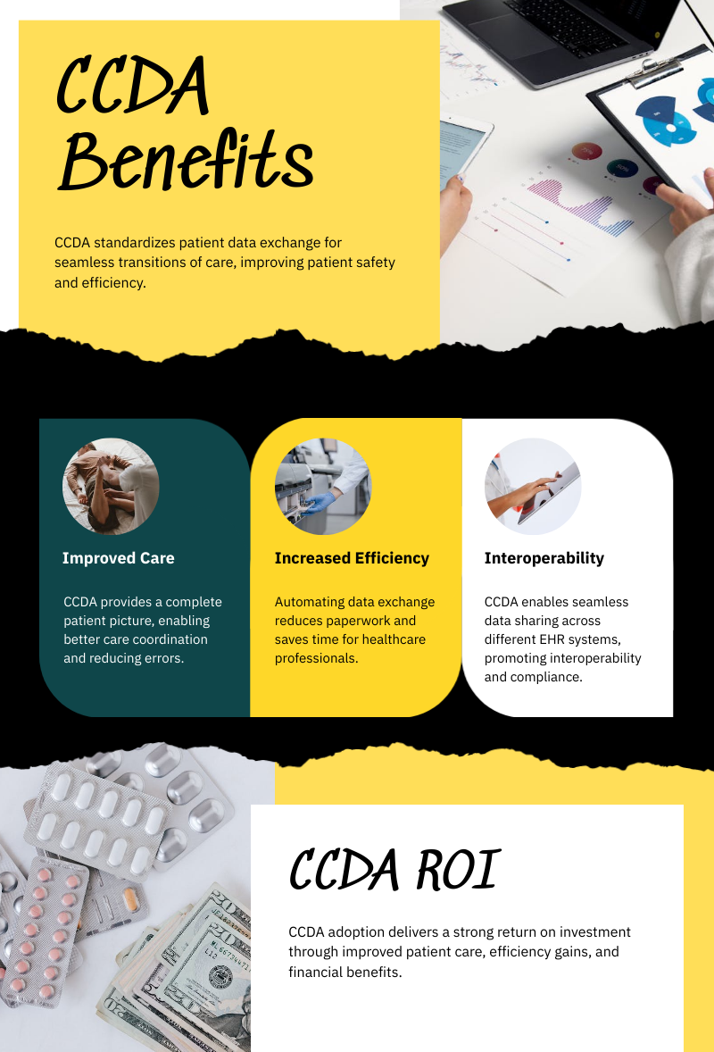
CCDA Benefits
Improved Patient Care-Provides complete patient information
Increased Efficiency-Automates data exchange, saving time and reducing paperwork.
Interoperability-Ensures data standardization and compatibility across EHRs

Slide 17
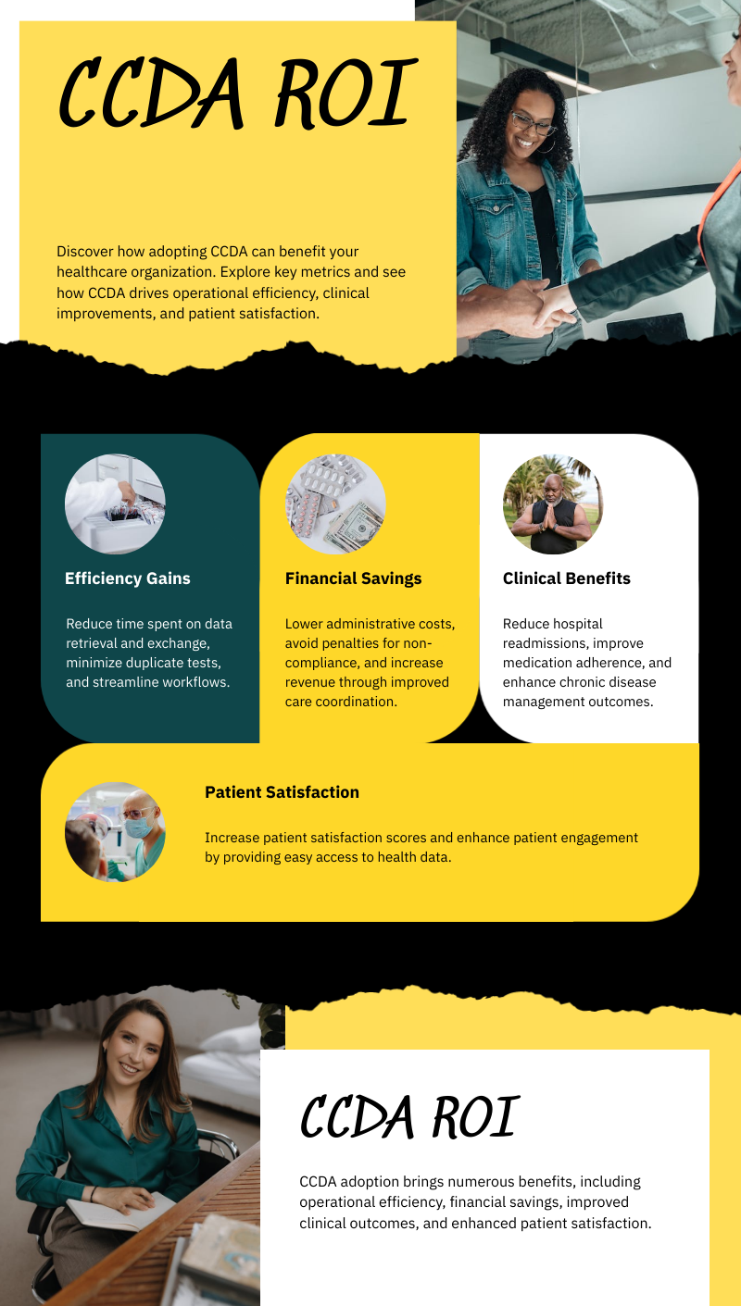
RETURN OF INVESTMENT (ROI)
Case Studies
Sentara Healthcare:
Reduced hospital readmissions by 20%.
Saved thousands of hours annually by cutting data retrieval time by 40%.
Geisinger Health System:
Improved diabetes outcomes by 15%.
Reduced test duplication rates by 25%, saving $3 million annually.
Kaiser Permanente:
Improved patient satisfaction by 30%.
Achieved full ROI within two years via cost reductions and better care coordination.

Slide 18
Keypoints covered in the presentation
C-CDA is a standard element for the exchange of clinical information.
It is a significant part of HL7 standards
It is used to ascertain interoperability between various E.H.R. systems.
It facilitates patient health information from one healthcare center to another wherever it is needed.
It improves the quality of patient care, reduces the risk of errors, and improves treatment outcomes.
It provides discharge summaries, patient history, and referral reports.

Slide 19
Importance of C-CDA in Modern Healthcare
Interoperability - C-CDA ensures that the electronic health record system can communicate accurately and precisely.
Continuity of care – By providing the exchange of clinical reports during the transition of care, C-CDA affirms that healthcare providers have precise and important patient information. Resultantly, it minimizes the risk of medical errors.
Improvement the Patient Outcomes- it can access accurate and complete patient information which ensures healthcare providers make precise informed decisions, and improve treatment outcomes.

Slide 20
Importance of C-CDA in Modern Healthcare
Efficiency- saves time in exchanging clinical information and providing resources for healthcare providers. and minimizes the risk of miscommunication.
Compliance Regulatory - Using C-CDA helps and enforces the healthcare organization to follow all regulatory requirements like the HIT and HITECH Act in the USA.
Data Integrity and Security- standardized architecture like C-CDA ensures the patient's data is well organized, precise, and secure. This is very important for maintaining the integrity of medical records and protecting all sensitive documents.

Slide 21
Conclusion
In a nutshell -C-CDA plays a significant role in augmenting the
quality, safety, and efficiency of healthcare delivery. It supports
the exchange of clinical information coherently, leading to
potential quality care and treatment outcomes for patients.

Slide 22
Thank you

